Slide 1
Data Organization and Retrieval (File Organization)
Subhasis Bhattacharjee
Computer Science & Engineering, IIT Jammu

Slide 2
File
A file is an external collection of related data treated as a unit.
Files are stored in auxiliary/secondary storage devices.
Disk
Tapes
A file is a collection of data records with each record consisting of one or more fields

Slide 3
File Organization
The method / way data is stored in a file
Combination –
representations for data in files
operations for accessing the data.
What applications gets from File Organization
Read, write and modify data / record
Support finding the data that matches some search criteria
Reading / Returning data in some particular order.

Slide 4
Storage of Data in Computers
Primary Storage ==> Memory [RAM]
Fast but limited in size
Secondary Storage [Online Disk / Tape / CDRom that can be accessed by the computer]
Slow but huge space
Around 20x slower
Can archive data [Offline Disk/Tape/ CDRom not directly available to the computer.]

Slide 5
Storage of Data in Computers - 2
Cloud storage =>
Stores data on the Internet through a cloud computing provider who manages and operates data storage as a service
It’s delivered on demand with just-in-time capacity and costs
Eliminates buying and managing your own data storage infrastructure
Provide agility, global scale and durability, with “anytime, anywhere” data access.

Slide 6
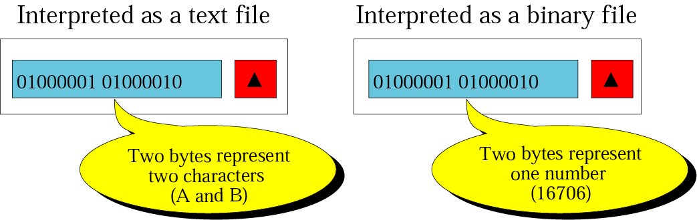
Text and Binary interpretations of a file
A file stored on a storage device is a sequence of bits that can be interpreted by an application program as a text file or a binary file.

Slide 7
Text vs. Binary
Text files –
A file of characters.
Cannot contain integers, floating-point numbers, etc in their internal memory format.
Encoding system – ASCII or EBCDIC …
Binary files –
A collection of data stored in the internal format of the computer.
Contain data that are meaningful only if they are properly interpreted by a program.

Slide 8
Serialization
Motivation
A lot of code involves boring conversion from a file to memory
This is a common problem!
Objects have state in memory
Serialization is the process of converting objects into a streamed state (Network, Disk)
No notion of an address space in disk
No pointers in disk
Serialization is also called
Flattening, Streaming, Dehydrate (rehydrate = read), Archiving

Slide 9
Serialization / Deserialization
Object in memory
…binary or character stream…
Object in memory

Slide 10
Serialization - Requirements
Serialization is the process of converting an object, or a connected graph of objects, stored within computer memory, into a linear sequence of bytes
Use the sequence of bytes in several ways:
Send it to another process
Send it to the clipboard, to be browsed or used by another application
Send it to another machine
Send it to a file on disk

Slide 11
Serialization - Process
To write out an object
ObjectOutputStream out;
out.writeObject(obj)
To read that object back in
ObjectInputStream in;
obj = in.readObject();
Must be of the same type
class and version
The serialized stream might be encoded using XML / JSON, or a compact binary representation

Slide 12
Serialization - Process
System knows how to recursively write out the state of an object
Recursively follows pointers and writes out those objects too!
Can handle most built in types
int, array, Point etc.

Slide 13
Object Graph
What is an object graph?
An object graph is a set of objects with some set of references to each other
The most obvious problem is how to represent the links between the objects in the Serialized stream
3
Dog
4
Cat
7
Cat
1
Mouse
9
Horse
2
Duck

Slide 14
Creating a Sequential File using Object Serialization
In an object - every attributes / variable must be serializable
All primitive-type variables
For reference-type variables / attributes – it’s object is to be made serializable
Some data may be declared as transient
it will be ignored during the serialization process

Slide 15
Physical versus Logical Files
Physical File: A collection of bytes stored on a disk or tape.
Logical File: A “Channel” (like a telephone line) that hides the details of the file’s location and physical format to the program.
When a program wants to use a particular file, “data”
Operating system must find the physical file called “data”
Make the hookup by assigning a logical file to it
Logical file name / id is used inside the program.
File name to physical location on disk – mapping between logical & physical file

Slide 16
Unsuitability of Tree in Files
AVL trees are good for data in memory / RAM.
Not good for files – why ?
Single data / key per node
Too much balancing / rotation – reordering of nodes – and reading & rewriting many blocks in the disk
B-Trees are more suitable for files –why ?
More data can be fetched in 1 disk access
Many half-filled nodes are available – new data can be inserted
Hardly node splitting reach till root node (and height increases)
One file entry with only 3 or 4 access to the disk - (among millions in practice)

Slide 17
B-Tree in Files
B+ Tree are even more suitable –
Better indexing – hardly indexing changes in internal nodes
Internal nodes do not keep data – so more keys per node
Hybrid index mechanism is more suitable for organizing data in files
Hierarchical Index mechanism
Hashing / extendable dynamic hashing – for fixed files - guarantees one or at most two disk accesses no matter how big a file becomes

Slide 18
Disk Access mechanism
Disk allows direct access to sector
Indexes made it possible to keep a list of keys and pointers in a small file / record that could be searched very quickly
With the key and pointer, the user had direct access to the large, primary file

Slide 19
Operations on Files & Requirements
Actual operations on File
Opening and Closing Files
Reading, Writing and Seeking
What we need
Finding data / record
Writing new data
Updating old data
Sequencing / streaming of existing data – reading a pdf file, video streaming etc.

Slide 20
Disk
Disks belong to the category of Direct Access Storage Devices (DASDs) because they make it possible to access the data directly
The information stored on a disk is stored on the surface of one or more platters.
The information is stored in successive tracks on the surface of the disk.
Each track is often divided into a number of sectors which is the smallest addressable portion of a disk
When a read statement calls for a particular byte from a disk file, the computer’s operating system finds the correct platter, track and sector, reads the entire sector into a special area in memory called a buffer, and then finds the requested byte within that buffer.

Slide 21
Disk
Disk drives typically have a number of platters and the tracks that are directly above and below one another form a cylinder.
All the info on a single cylinder can be accessed without moving the arm that holds the read/write heads.
Moving this arm is called seeking. The arm movement is usually the slowest part of reading information from a disk

Slide 22
Disk Capacity
Track Capacity = number of sectors per track * bytes per sector
Cylinder Capacity = number of tracks per cylinder * track capacity
Drive Capacity = number of cylinders * cylinder capacity

Slide 23
File Organization in Disk
The file can also be viewed as a series of clusters of sectors which represent a fixed number of (logically) contiguous sectors.
Once a cluster has been found on a disk, all sectors in that cluster can be accessed without requiring an additional seek.
The File Allocation Table ties logical sectors to the physical clusters they belong to
If there is a lot of free room on a disk, it may be possible to make a file consist entirely of contiguous clusters. ==> the file consists of one extent. ==> the file can be processed with a minimum of seeking time.
If one extent is not enough, then divide the file into more extents.
As the number of extents in a file increases, the file becomes more spread out on the disk, and the amount of seeking necessary increases

Slide 24
Non-Data Overhead
Whether using a block or a sector organization, some space on the disk is taken up by non-data overhead. i.e., information stored on the disk during pre-formatting.
On sector-addressable disks, pre-formatting involves storing, at the beginning of each sector, sector address, track address and condition (usable or defective) + gaps and synchronization marks between fields of info to help the read/write mechanism distinguish between them.
On Block-Organized disks, subblock + interblock gaps have to be provided with every block. The relative amount of non-data space necessary for a block scheme is higher than for a sector-scheme

Slide 25
General Goal in working ext storage
Get the information we need with as few access to the disk as possible
Perhaps with one access only
Group information so that we get everything that we need with only one access to the disk
Different file structure designs require for
Fixed files – data never changes
Dynamic files – files grow / shrink – data add / delete

Slide 26
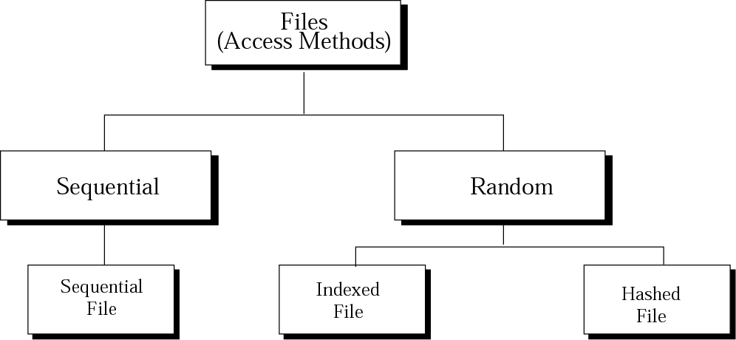
Taxonomy of file structures
The access method can be sequential or random
One record after another, from beginning to end
Access one specific record without having to retrieve all records before it

Slide 27
Methods of File Organization
Sequential
Random
Serial
Indexed-sequential

Slide 28
Sequential file organization
Records are stored and accessed in a particular order sorted using a key field.
Retrieval requires searching sequentially through the entire file
If records are sorted - binary search technique can be used

Slide 29
Sequential file organization - disadvantage
Adding new record
May need a total re-writing of file – if records are sorted
Retrieval requires searching sequentially through the entire file record by record (if unsorted)

Slide 30
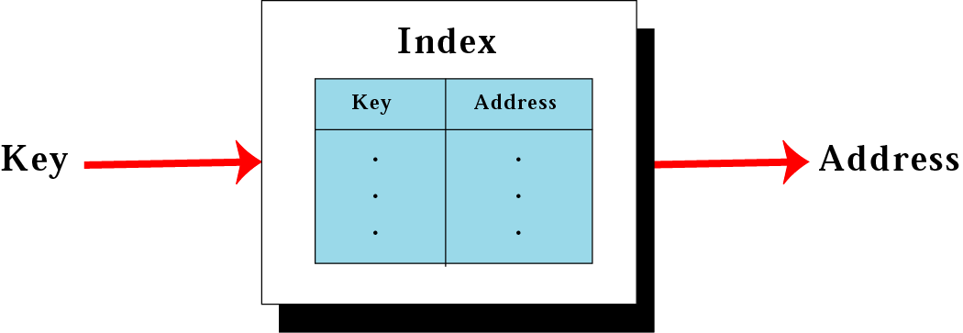
Mapping in an indexed file
To access a record in a file randomly, you need to know the address of the record.
An index file can relate the key to the record address

Slide 31
Indexed files
An index file is made of a data file, which is a sequential file, and an index.
Index – a small file with only two fields:
The key of the sequential file
The address of the corresponding record on the disk.
To access a record in the file :
Load the entire index file into main memory.
Search the index file to find the desired key.
Retrieve the address the record.
Retrieve the data record. (using the address)
Inverted file – you can have more than one index, each with a different key.

Slide 32
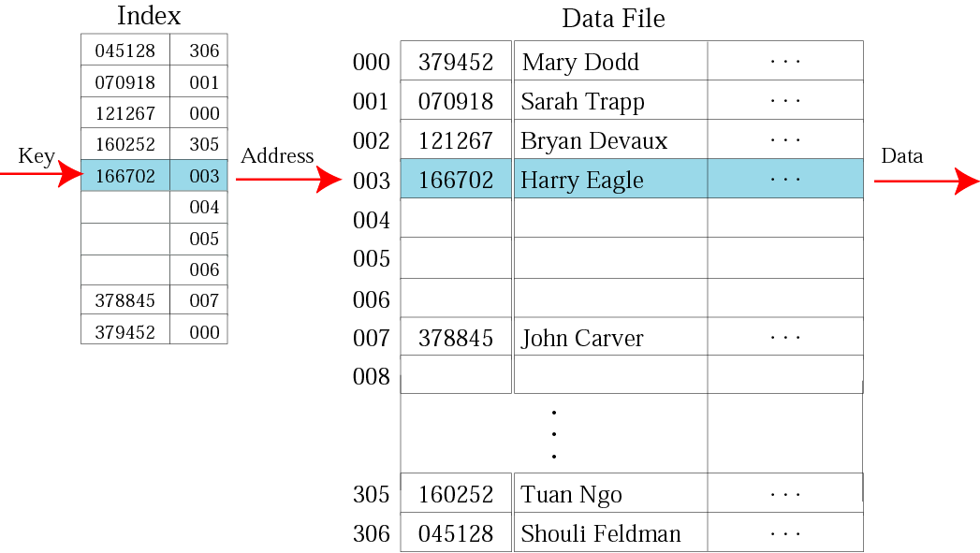
Logical view of an indexed file

Slide 33
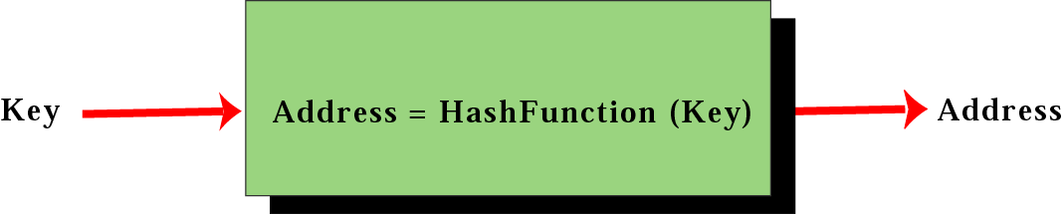
Mapping in a hashed file
A hashed file uses a hash function to map the key to the address.
Eliminates the need for an extra file (index).
There is no need for an index and all of the overhead associated with it.

Slide 34
Cost of a disk access
Seek Time is the time required to move the access arm to the correct cylinder.
Rotational Delay is the time it takes for the disk to rotate so the sector we want is under the read/write head.
Transfer Time = (Number of Bytes Transferred/ Number of Bytes on a Track) * Rotation Time
Disk access time is quite significant compared to RAM access & CPU processing.

Slide 35
Reducing Disk Access Time
RAID: Redundant Array of Independent Disks
RAM disk: Simulate the behavior of the mechanical disk in RAM
Disk Cache: large block of RAM configured to contain pages of data from a disk. Check cache first. If not there, go to the disk and replace some page already in cache with page from disk containing the data.

Slide 36
Finding Data in Files
The cost of Seeking is very high.
This cost has to be taken into consideration when determining a strategy for searching a file for a particular piece of information.
The same question also arises with respect to sorting, which often is the first step to searching efficiently.
Rather than simply trying to sort and search, we concentrate on doing so in a way that minimizes the number of seeks
We are interested in more efficient ways to retrieve records based on their key-value
In order to use binary search, though, the file first has to be sorted. This can be very expensive
If the entire content of a file can be held in memory, then we can perform an internal sort. Sorting in memory is very efficient

Slide 37
Finding Data in Files - 2
However, if the file does not hold entirely in memory, any sorting algorithm will require a large number of seeks. Sorting would, thus, be extremely slow. Unfortunately, this is often the case, and solutions have to be found

